Slide 1
EXPOSYS DATA LABS DATA SCIENCE INTERNSHIP NAME – NIKHIL SONI PHONE NO. – 9792658562 INTERNSHIP AREA – DATA SCIENCE PROJECT NAME – DIABETES PREDICTION

Slide 2

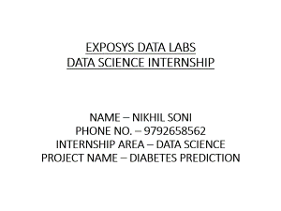
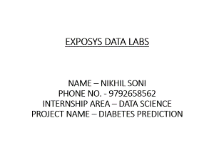

Slide 3
Diabetes prediction using python
Diabetes has become one of the major causes of national disease and death in most countries.
According to the International Diabetes Federation report, the figure is expected to rise to more than 642 million in 2040, so early screening and diagnosis of diabetes patients have great significance in detecting and treating diabetes on time.
Diabetes is a multifactorial metabolic disease, its diagnostic criteria is difficult to cover all the ethology, damage degree, pathogenesis and other factors, so there is a situation for uncertainty and imprecision under various aspects of medical diagnosis process.
With the development of Data mining, researchers find that machine learning is playing an increasingly important role in diabetes research.

Slide 4
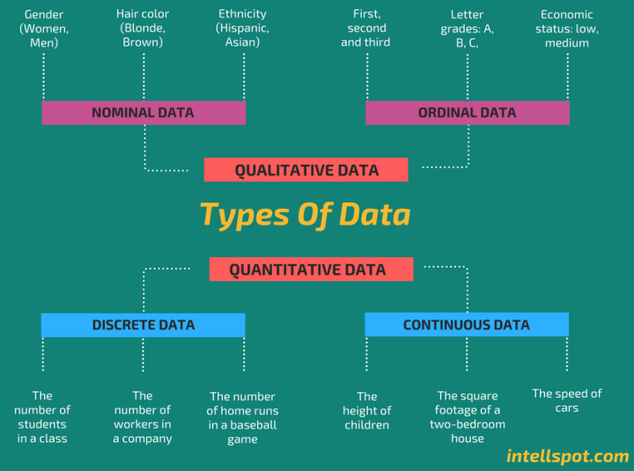

Slide 5
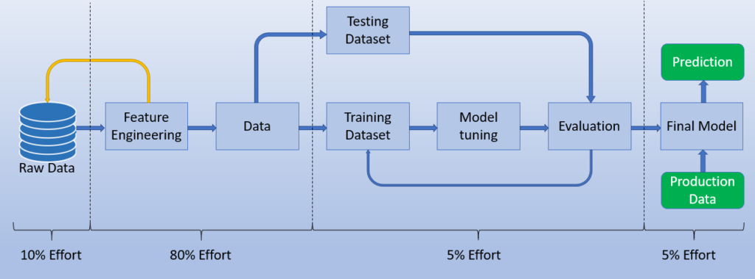
Steps of implementing the model

Slide 6
Softwares and libraries required
Google Colab
Python Libraries:
Pandas
Numpy
StandardScaler
train_test_split
svm
accuracy_score

Slide 7
Algorithms used
KNeighborsClassifier.
SVC.
GaussianNb
Random forest classifier.

Slide 8
Advantages
The advantage of this method is the whole samples in the dataset are trained and tested, which can avoid the higher variance . In this study, we used the five-fold cross validation method.
Prediction of diabetes at an early stage can lead to improved treatment.
Data Science techniques are widely used for prediction of disease at an early stage. In this research paper, diabetes is predicted using significant attributes, and the relationship of the differing attributes is also characterized.
Risk stratification by sudomotor test has more accuracy than standard clinical test.

Slide 9
Conclusion
The main aim of this project was to design and implement Diabetes Prediction Using Machine Learning Methods and Performance Analysis of that methods and it has been achieved successfully.
The proposed approach uses various classification and ensemble learning method in which SVM, KNN, Random Forest, Decision Tree, Logistic Regression and Gradient Boosting classifiers are used.
The Experimental results can be assist health care to predict and make early decision to cure diabetes and save humans life.

Slide 10
THANK YOU

